Slide 1




Digital Medical Device Lifecycle & Risk Management Platform
Rohan Singh

Slide 2

Tools Used
Wireframing: Figma
BI & Analytics: Power BI / Tableau
Mock Data: Excel / Simulated CSV
Methodology
Data creation (mock)
Visualization & dashboard building
Iterative design and filter logic updates
Key metrics tracked: Device Status, Equipment Type, Location, Technician, Trends
🧠 Strategic Insight (Consulting Angle):
Most global tools (like GE) focus on device monitoring and integration with EMRs, not lifecycle or compliance management. Indian hospitals either lack platforms entirely or rely on paper-based reporting. This leaves a significant market gap for a lightweight, modular tool that:
Tracks device usage and health
Scores risks (per ISO 14971)
Visualizes dashboards for admins
Generates audit-ready reports
Works in low-resource hospital environments

Slide 3
Project Plan & Methodology
Project Overview
Problem Identification: Manual logs, non-transparent & delayed preventive maintenance of faults in medical devices
Problem Identification Via Academic Clinical Exposure
Requirements & scope definition
UI Designs & Wireframes
Data Simulation & Preparation
Dashboard development & KPI Visualisation
Observed Workflows , and staff reviews
Stakeholder mapping, needs & MVP
Tools - Figma
Tools - Mock data – clinical visits, web source, Excel
Tools – PowerBI
Reporting & documentation
Tools – MS Powerpoint, Github
Objectives: Design a digital platform that enables hospitals to track, assess, and optimize the lifecycle of medical devices while aligning with ISO 14971 risk management standards.
Goals
Track device health and usage
Visualize risks and maintenance load
Create audit-ready reports
Location: Large Government Hospital
Key metrics tracked: Device Status, Equipment Type, Location, Technician, Trends

Slide 4
🧾 Stakeholder Needs & Challenges
Project Context: Digital Medical Device Lifecycle & Risk Management Platform for a Large Government Hospital
This section presents an analysis of the primary and secondary stakeholders involved in the lifecycle management of medical devices within a large public healthcare institution. Understanding stakeholder roles, responsibilities, and pain points is critical for aligning platform features with real-world clinical workflows and regulatory expectations.
A large government hospital operates in a resource-intensive, compliance-driven environment. Devices are used and maintained by multidisciplinary teams, and failures or inefficiencies can impact patient safety, operational continuity, and accreditation status (e.g., NABH, ISO 14971compliance). The following table summarizes key stakeholders, their core functions, existing challenges, and strategic requirements from the proposed platform.

Slide 5

Stakeholder Mapping
Stakeholder Role | Responsibility | Pain Points | Needs / Expectations
Biomedical Engineer | Maintenance, calibration, inventory tracking | Paper logs, lack of alerts, no failure analytics | Real-time dashboards, performance insights
Clinical Staff (Nurses) | Device operation, error reporting | Slow reporting, poor training on new devices | Easy reporting app, training materials, clear SOPs
Maintenance Technician | Field repairs, emergency response | Doesn’t know what to fix until it breaks | Preventive maintenance forecast, auto-alerts
Hospital Admin | Budgeting, compliance, procurement | No lifecycle cost tracking, weak regulatory visibility | KPIs dashboard, risk flags, asset retirement roadmap
Regulatory Officer | Ensuring ISO 14971/NABH compliance | Manual logs, difficult audit prep | Pre-built risk reports, auto-documentation of failures
Pharmacist | Cold storage, drug-device interaction monitoring | Alerts for cold chain failure, lack of error incident visibility | Device health notifications, integration with medication logs

Slide 6

Competitor Analysis
Key Functionality/Need | GE CARESCAPE | AgileMD | Indian Govt Hospitals | Proposed Platform
Real-time device inventory | ✅ | ❌ | ❌ | ✅
ISO 14971-compliant risk scoring | ❌ | ❌ | ❌ | ✅
Incident reporting (mobile/web) | ❌ | ✅ | ❌ | ✅
Preventive maintenance alerts | ❌ | ❌ | ❌ | ✅
Dashboard with KPIs | ✅ | ❌ | ❌ | ✅
Auto-generated compliance reports | ❌ | ❌ | ❌ | ✅
Stakeholder-specific access levels | ✅ | ❌ | ❌ | ✅
Lifecycle cost tracking | ✅ | ❌ | ❌ | ✅

Slide 7
User Persona | Responsibilities | Role in Product | Tools used | Pain Points | Goals
Primary AJ Biomedical Engineer, 10+ Exp , Tier 1 Govt. Hospital | Maintenance, Failure tracking , communicating risk | Daily Operaor | Paper logs Excel WhatsApp Communication | Last-minute breakdowns No way to predict failure or show device performance to admin Difficult audits due to missing incident logs | Track device health in real time Get alerts for critical risks Generate automated reports for NABH inspections Improve response time to device incidents
NI Nurse 7 yrs ICU & Ward care | Uses devices daily First to observe problems | Incindent Initiator | Regularly calls for reporting and follow ups Leads to visits to BM dept Affects time for Patient care | Delay in reporting malfunctions No complain status updates | Quick reporting with mobile UI Track reolution status of reported issues Avoid Patient care delays due to faulty devices
Hospital Admin Exec Operations and compliance | Operational oversight, NABH readiness, budget approvals | Strategic Decision Maker | Read through paperwork and meeting reports | No dashboard to see risk heavy departments Chasing compliance data to audit deadline Don’t know overused devices/ Uptime% and underutilized devices | Get realtime device health analytics data to support budget requests Ensure NABH compliance throughout departments
Rx chief Pharmacist | Manages cold chain storage Insulin Pumps , drug delivery safety | Asset specific stakeholder | Paperwork and personnel notification if noticed | No notifications of storage malfunctioning Pharmacy losses due to unnoticed cold chain breaches | Realtime alerts when cold storage devices go outside safe range Maintain audit logs Coordinate better with engineering on maintenance

Slide 8

User Personas
Persona | Role in Hospital Workflow | Pain Points | Goals / What Success Looks Like
AJ Biomedical Engineer | Maintains and tracks all medical devices | Manual logs, no risk score visibility, audit overload | Real-time dashboard, automated risk scoring
Ni Head Nurse | Uses devices and reports issues | Slow incident reporting, poor feedback loop | One-click reporting, status tracking on incidents
Hospital Admin Executive (ops & Compliance) | Handles compliance, budget, hospital ops | Lacks risk dashboards, can't track utilization or costs | KPI dashboards, cost-risk analytics, audit-ready reports
Rx Chief Pharmacist | Manages cold-chain and drug-linked devices | No alerts for device failure, pharmacy losses | Cold chain alerts, audit trail for storage devices

Slide 9
Minimum Viable Product
Feature Name | Description
Device Inventory Tracker | Register devices with department, model, status, and maintenance dates
Incident Reporting Module | Allow clinical staff to report issues via web or mobile app
ISO 14971 Risk Scoring Tool | Auto-calculate risk score based on severity, likelihood, and detectability
Maintenance Log & Alerts | Trigger maintenance tasks based on risk score or scheduled dates
Admin Dashboard | View KPIs: incidents per dept, risk trends, device utilization
Compliance Report Generator | Export PDF/Excel of incidents, risk actions for audit
Unique Value Proposition
A lightweight, audit-ready platform for large hospitals to track medical device health, automate risk scoring, and streamline compliance—without needing expensive hardware or infrastructure.

Slide 10
🧩 2. Persona-Feature Mapping Table (MVP Prioritization Tool)
Feature Name | Arjun (Engineer) | Nisha (Nurse) | Ajay (Admin) | Shruthi (Pharmacist) | Priority
Device Inventory Management | ✅ | ❌ | ✅ | ✅ | 🔵 High
Risk Scoring (ISO 14971) | ✅ | ❌ | ✅ | ✅ | 🔵 High
Incident Reporting (Mobile/Web) | ✅ | ✅ | ❌ | ✅ | 🔵 High
Maintenance Scheduling | ✅ | ❌ | ✅ | ❌ | 🟢 Medium
Dashboard – Real-Time KPIs | ✅ | ❌ | ✅ | ✅ | 🔵 High
Compliance Report Generator | ✅ | ❌ | ✅ | ✅ | 🔵 High
Cold Storage Alerts | ❌ | ❌ | ❌ | ✅ | 🟠 Low (Asset-specific)
Multi-Role Access Control | ✅ | ✅ | ✅ | ✅ | 🟢 Medium

Slide 11
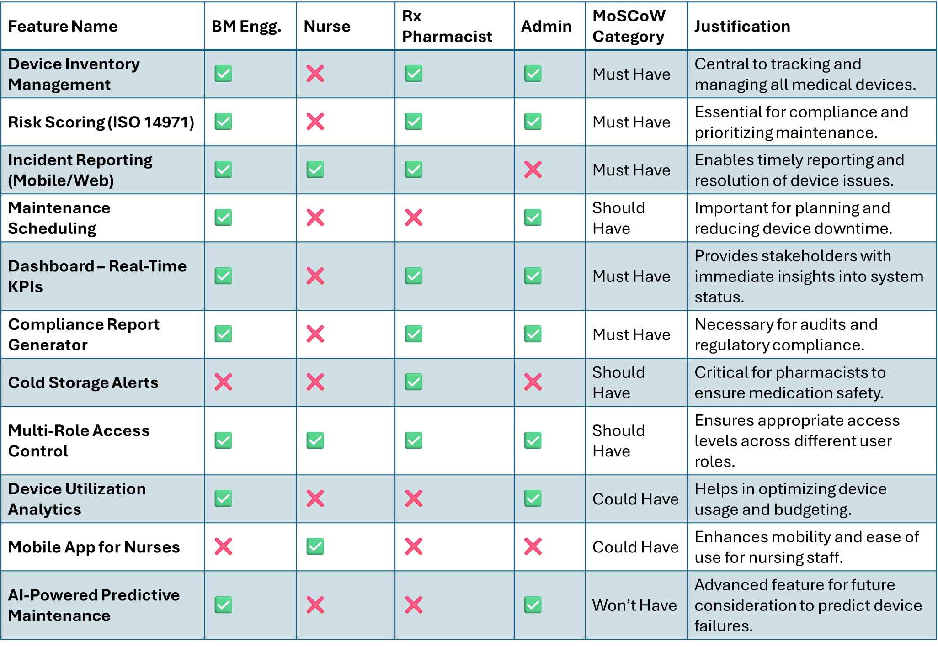
🧭 MoSCoW Prioritization Framework

Slide 12
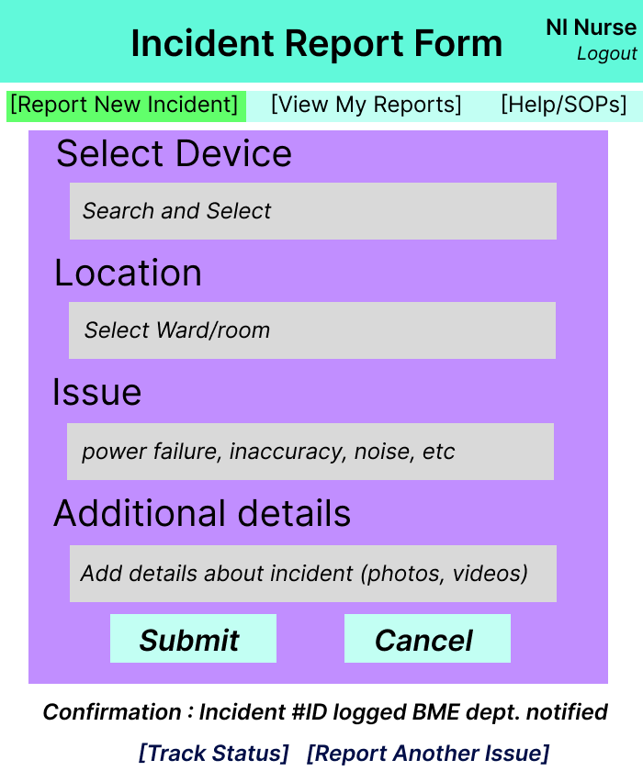
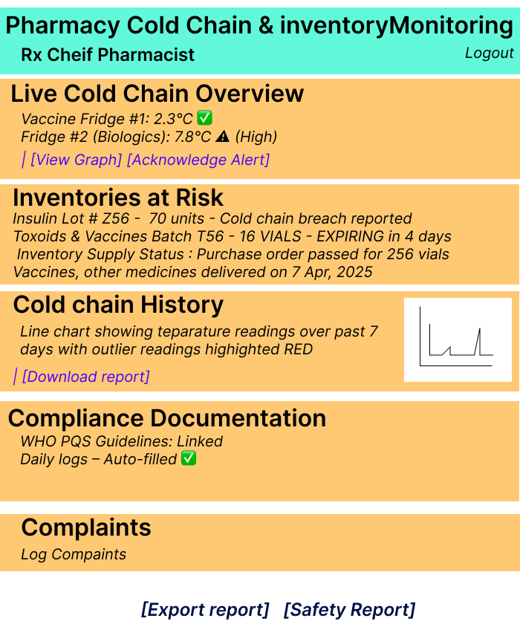
Wireframes
Head Nurse’s dashboard Incident Initiator
Rx Pharmacist’s dashboard
Asset specific stakeholder

Slide 13
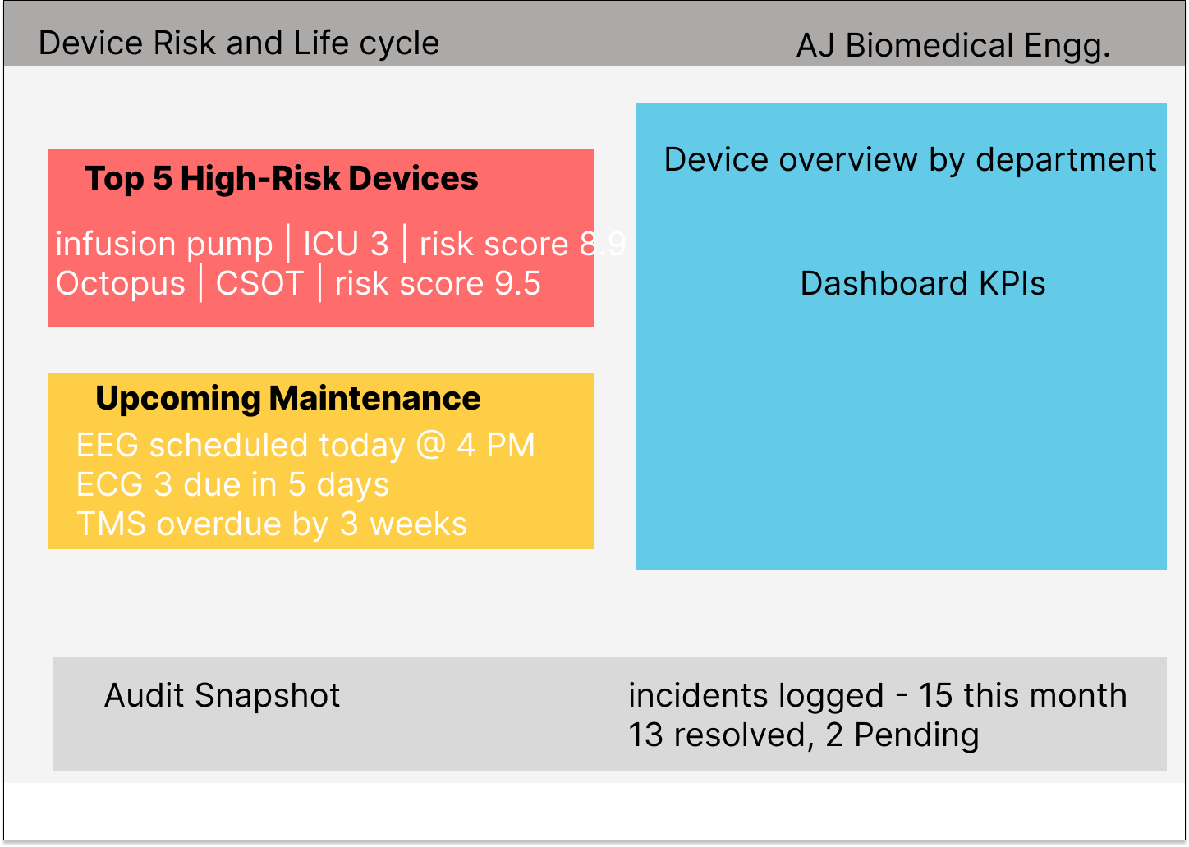
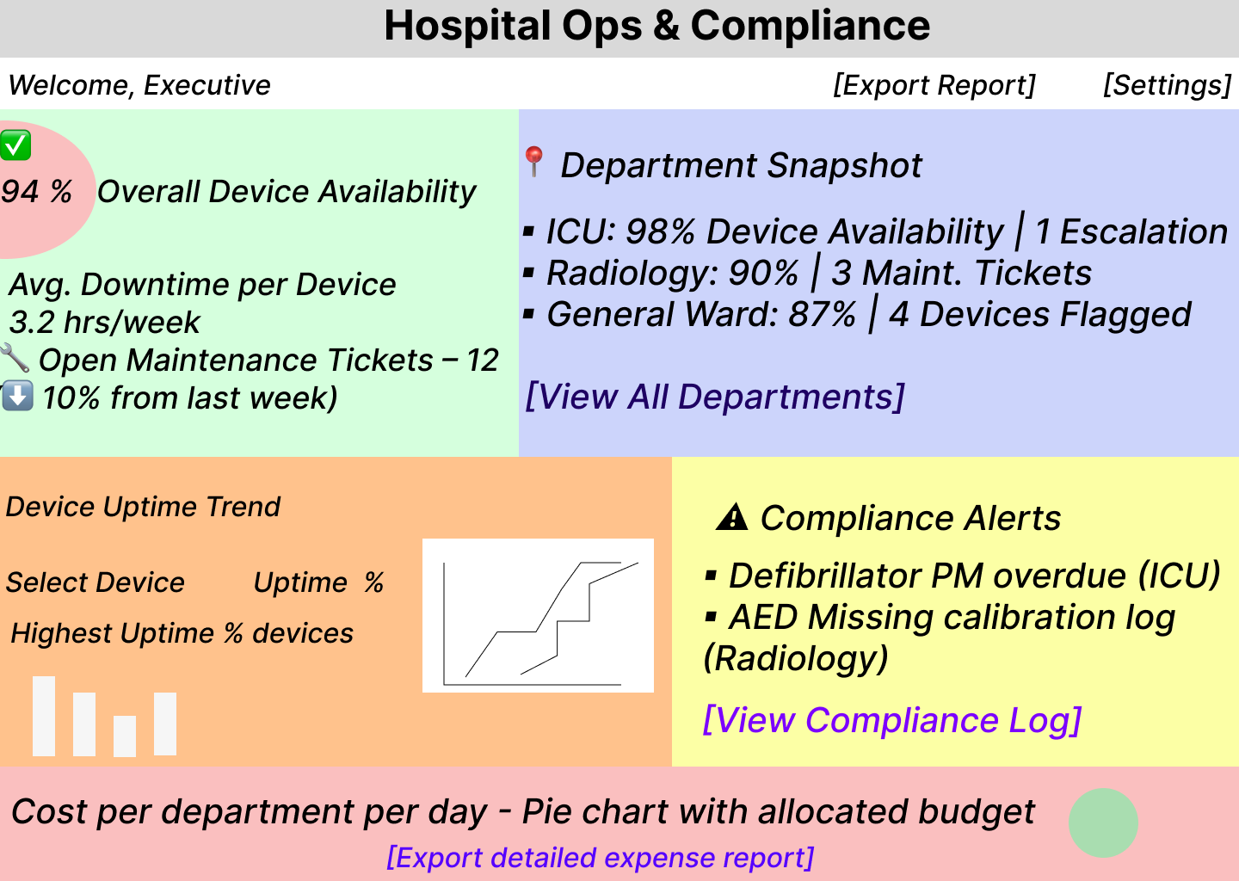
Wireframes
AJ Biomedical Engineer’s dashboard
Daily operator
Hospital Admin executive dashboard
Decision Maker

Slide 14
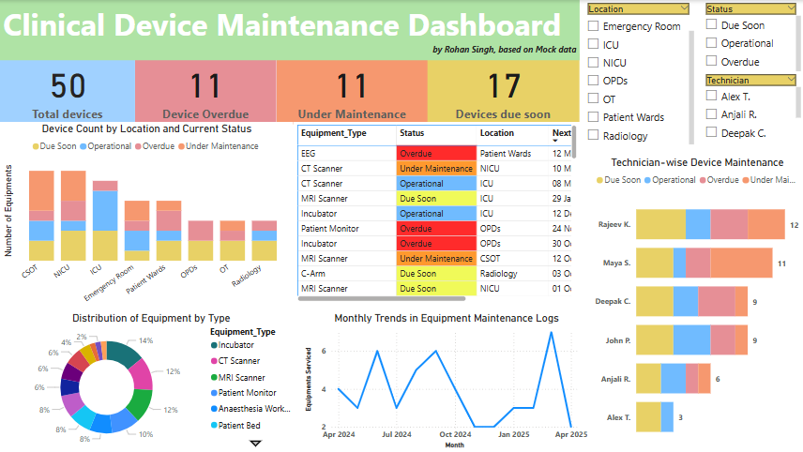

Slide 15
Insights
Dashboard solution
Schedule tasks based on device status
Tracks operational status, raise alerts
Issue logs
Review KPI, Downtime, workload
Device Risk & Maintenance
Technician Overload
Location Based Status
Equipment Distribution
Trend Analysis
Audit Readiness

Slide 16
Outcome & Benefits
Visual system to alert risks before failure
Better tech allocation
Simplified audits for NABH
Future Scope:
Integrate with IoT / real-time alerts
Mobile technician interface
Predictive maintenance with AI

Slide 17
Rohan Singh
Linkedin
Github
Email
Rohan Singh
Rxrohans
rohans.dmvt@gmail.com

Slide 18
🧭 MoSCoW Prioritization Framework 📋 Feature Prioritization Table
Feature Name | BM Engg. | Nurse | Rx Pharmacist | Admin | MoSCoW Category | Justification
Device Inventory Management | ✅ | ❌ | ✅ | ✅ | Must Have | Central to tracking and managing all medical devices.
Risk Scoring (ISO 14971) | ✅ | ❌ | ✅ | ✅ | Must Have | Essential for compliance and prioritizing maintenance.
Incident Reporting (Mobile/Web) | ✅ | ✅ | ✅ | ❌ | Must Have | Enables timely reporting and resolution of device issues.
Maintenance Scheduling | ✅ | ❌ | ❌ | ✅ | Should Have | Important for planning and reducing device downtime.
Dashboard – Real-Time KPIs | ✅ | ❌ | ✅ | ✅ | Must Have | Provides stakeholders with immediate insights into system status.
Compliance Report Generator | ✅ | ❌ | ✅ | ✅ | Must Have | Necessary for audits and regulatory compliance.
Cold Storage Alerts | ❌ | ❌ | ✅ | ❌ | Should Have | Critical for pharmacists to ensure medication safety.
Multi-Role Access Control | ✅ | ✅ | ✅ | ✅ | Should Have | Ensures appropriate access levels across different user roles.
Device Utilization Analytics | ✅ | ❌ | ❌ | ✅ | Could Have | Helps in optimizing device usage and budgeting.
Mobile App for Nurses | ❌ | ✅ | ❌ | ❌ | Could Have | Enhances mobility and ease of use for nursing staff.
AI-Powered Predictive Maintenance | ✅ | ❌ | ❌ | ✅ | Won’t Have | Advanced feature for future consideration to predict device failures.

